Slide 1








EXPLORING CUSTOMER PURCHASE BEHAVIOR: A RETAIL ANALYTICS CASE STUDY ON BLACK FRIDAY SALES
GROUP VII:
1.BED PRAKASH PRADHAN. 2.ANURAG SINGH
3.EEBAD REZA.
4.OM MOHANTY.
5.SATYAJEET MOHAPATRA.

Slide 2








Introduction
The project "Exploratory Data Analysis and Customer Purchase Behavior Analysis in Retail" aims to analyze customer purchase behavior during the Black Friday sales event using retail analytics techniques. By delving into the provided dataset, we seek to uncover valuable insights into customer preferences, spending patterns, and product categories that drive sales. Through data manipulation, visualization, and machine learning models, we aim to provide actionable recommendations to enhance sales and marketing strategies for "ABC Private Limited," a retail company.
Black Friday is an annual shopping event in the United States, occurring on the Friday following Thanksgiving Day. It is characterized by heavily promoted sales and exclusive discounts, marking the beginning of the Christmas shopping season.
Retailers can leverage data analytics during Black Friday to understand customer purchase behavior, optimize product offerings, pricing strategies, and tailor personalized discount vouchers. This data-driven approach helps businesses stay competitive and cater to customer needs, maximizing sales during this crucial shopping season.

Slide 3






Data Overview
Key Variables and Definitions from the Data Dictionary:
Dataset Used in the Project:
The dataset used in the project is a purchase summary of various customers for selected high-volume products from the last month. It includes information about customer demographics (e.g., age, gender, marital status, occupation), product details (e.g., product ID, product category), city category, stay-in-current-city years, and the total purchase amount.
User_ID: User ID
Product_ID: Product ID
Gender: Sex of the user (Male or Female) {Catogorical}
Age: Age of the user, grouped into bins {Catogorical}
Occupation: Occupation of the user (masked or anonymized)
City_Category: Category of the city (A, B, or C) {Catogorical}
Stay_In_Current_City_Years:Number of years the user has stayed in the current city {Catogorical}
Marital_Status: Marital status of the user (0 - Unmarried, 1 - Married)
Product_Category_1: Product category (masked or anonymized) {Catogorical}
Product_Category_2: Product may belong to another category as well (masked or anonymized)
Product_Category_3: Product may belong to another category as well (masked or anonymized)
Purchase: Purchase amount (target variable)

Slide 4
Descriptive Analysis
Library used
pandas(manipulation and analysis), NumPy(numerical computing), sklearn(algorithms and tools for data mining and analysis), seaborn(data visualization library based on Matplotlib), matplotlib(static, interactive, and animated visualizations), plotly(versatile graphing library), warning(potential issues or deprecated features)
Some the important command used to analysis the data
1. data.shape [Checking The Dimension Of the DataSet]
2. data.nunique()[Unique elements in each attributes]
3. Frequency & Relative Frequency for Each Column {data['Gender'].value_counts(), data['Gender'].value_counts(normalize=True) }
4. data.info() {prints information about the DataFrame [columns, column labels, column data types, Non-Null, Count,Dtype]}
5. data.dtypes {Catogorical or non-catogorical}
6. data.describe() {count,mean,std,min,max,25%,50%,75%}
7. data[data.duplicated()].sum(){for duplicate data(biased results,overfitting,negatively impact)}
8. data.isnull().sum() {Identifying the Missing Column Under Each Column}
9. #function missing_data(data) {Percentage Of Missing Value in Each Column}
10. data.hist() {Frequency check}
]

Slide 5


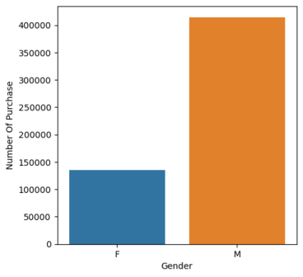
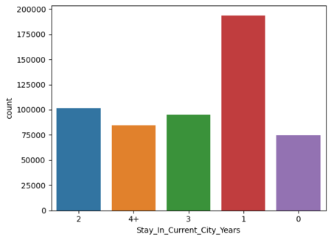
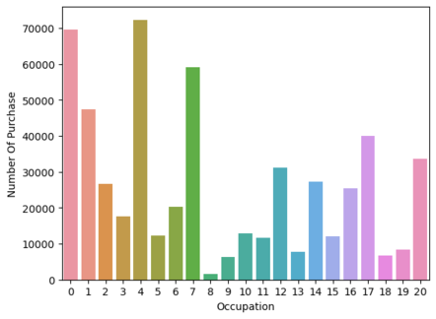
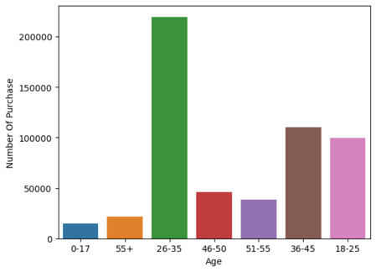
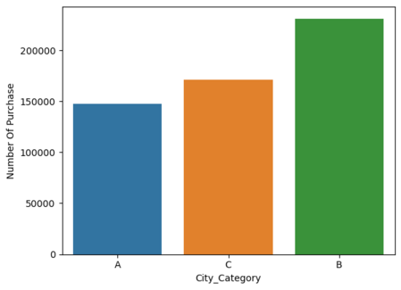
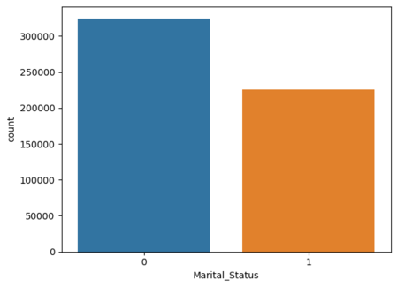
Exploratory Data Analysis(Univariate)

Slide 6
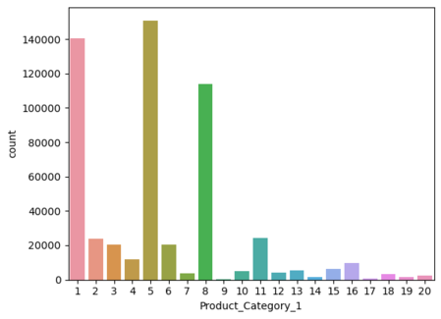
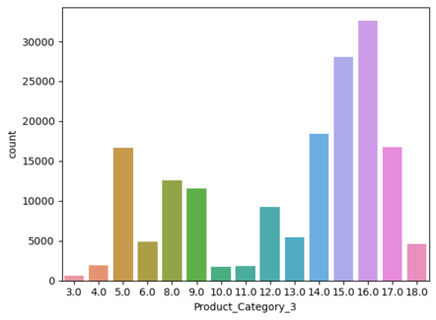
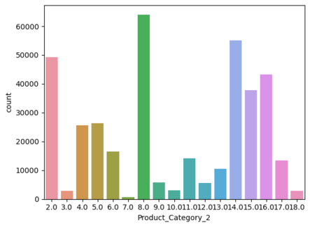
Exploratory Data Analysis(Univariate)

Slide 7
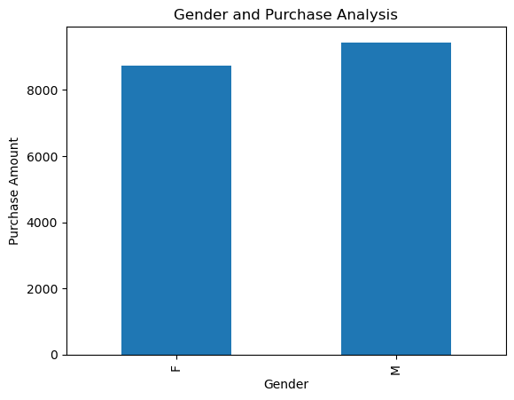
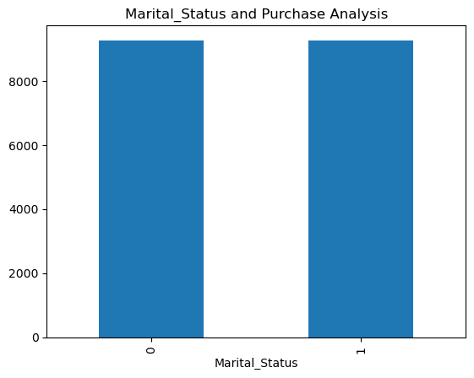
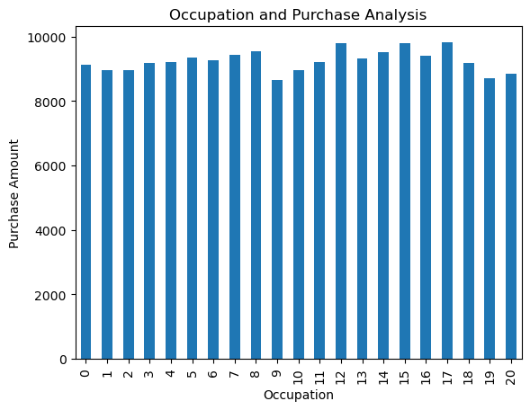
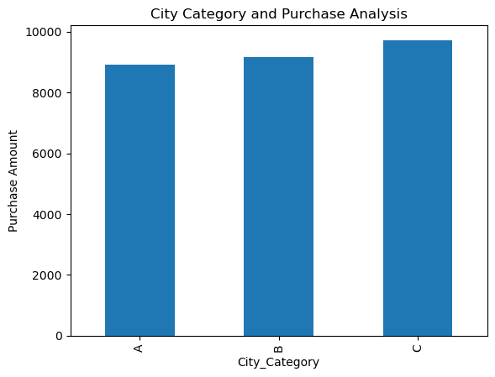
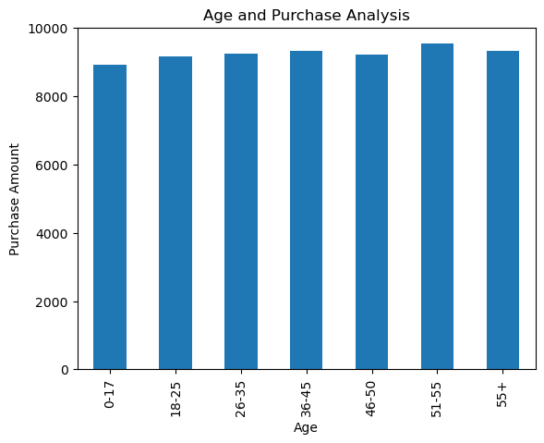
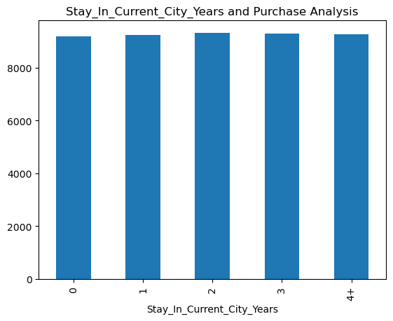
Exploratory Data Analysis(Bivariate)

Slide 8
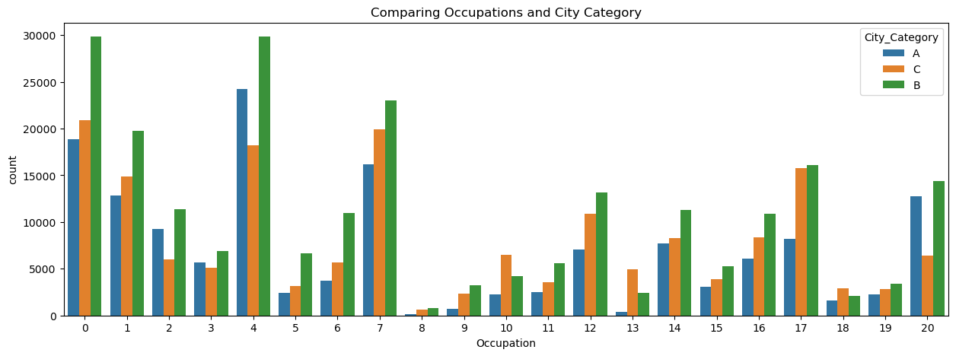
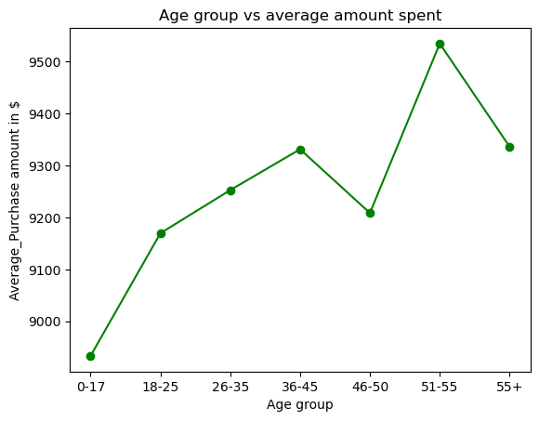
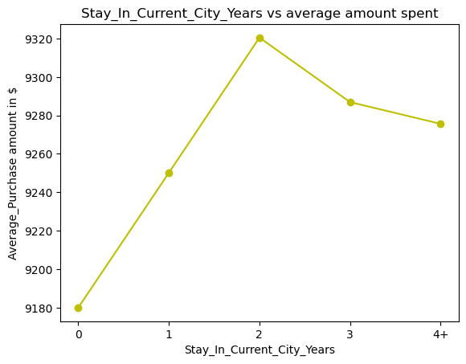
Exploratory Data Analysis(Bivariate)

Slide 9

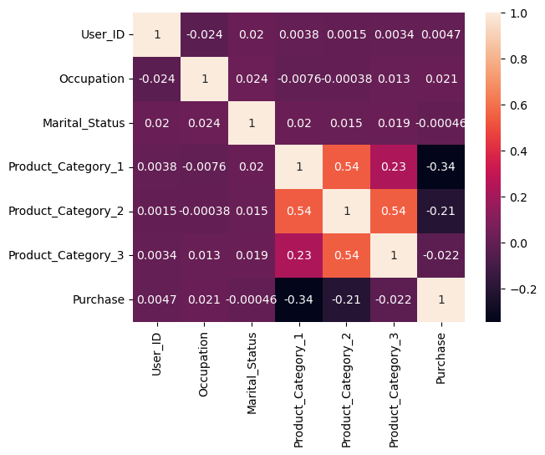
Data Pre-Processing
Discrepancies / Inconsistencies in data( Add some very few points to "Discrepancies / Inconsistencies in data Replacing '+' in 'Age' and 'Stay_In_Current_City_Years')
Dropping Irrelevant Data (Category_3and user_id) .
Pre-Processing the productID(# Product_ID preprocess e.g. P00069042 -> 69042)
Fixing null values in 'Product_Category_2' (#imputed missing values with random values in the same probability distribution as given feature already had)
Feature Encoding (Used labelled Encoding to convert the categorical data into numerical Data)
Convert'Age', 'Stay_In_Current_City_Years' and 'Product_Category_2' into numeric data type
Creating a train test split (# split the data and label)
Showing the relation between different attributes of the Dataset

Slide 10



Data Modelling
(1.a)Linear Regression
Linear regression is a statistical method that fits a straight line to data, allowing us to predict and understand relationships between variables.
(1.b)Ridge Regression: This model solves a regression model where the loss function is the linear least squares function and regularization is given by the l2-norm. Also known as Ridge Regression
(1.c) Lasso Regression: This model solves a regression model where the loss function is the linear least function and regularization is given by the l1-norm. Also known as Lasso Regression
(2)KNN Regression:
It predicts continuous values by averaging the 'K' nearest data points' target values from the training set to the new input data point.
RMSE - 4690.783
R² score-0.1294
RMSE - 4690.283
R² score-0.1294
RMSE - 4690.283
R² score-0.1294
RMSE - 2874.030
R² score-0.6732

Slide 11


Data Modelling
(3)Decision Tree Regression :It predicts numeric values using a tree-like model based on feature splits. It captures non-linear relationships between features for regression tasks.
(4)Random Forest Regressor: It is an ensemble algorithm using decision trees as base learners. It combines predictions from multiple trees to improve accuracy and handle noisy data.
(5)XGB Regressor
XGBoost is an advanced implementation of gradient boosting, known for high predictive power, speed, and regularization to reduce overfitting.
RMSE - 2872.67
R² score-0.6732
RMSE - 2782.466
R² score-0.693
RMSE - 2585.59
R² score-0.735

Slide 12


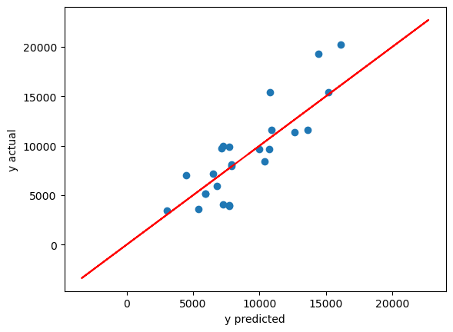
Conclusion
After evaluating and comparing various models, it is evident that the XGBRegressor model outperforms the others in predicting the purchase amount from our dataset.
Model Parameters and Performance:
Model: XGBRegressor
Parameters: n_estimators=500, max_depth=10, learning_rate=0.05
R-squared (R2) Score: 0.7356
Root Mean Squared Error (RMSE): 2584.9993
The high R2 score of 0.7356 indicates that approximately 73.56% of the variance in the purchase amount can be explained by the model. Moreover, the low RMSE value of 2584.9993 indicates that the model's predictions are quite accurate, with minimal errors.
Therefore, we confidently recommend utilizing the XGBRegressor model for predicting purchase amounts in future analyses and applications.

Slide 13
Any Questions?

Slide 14

Thank you!

